Slide 1
Chapter 1 - INTRODUCTION
Anh Nguyen-Duc
Tho Quan-Thanh
WEEK 1

Slide 2
Topics covered
Professional software development
What is meant by software engineering.
Ethical & sustainable software engineering
A brief introduction to ethical issues that affect software engineering.
Notes:
Topics covered
Professional software development
What is meant by software engineering.
Software engineering ethics
A brief introduction to ethical issues that affect software engineering.
Suggested student projects
A brief introduction to each suggested project that can be carried out by students for this course

Slide 3
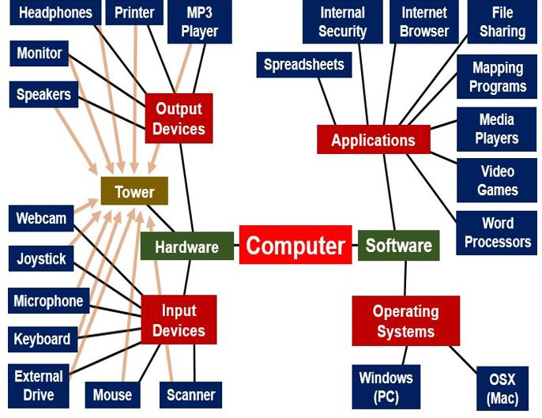
What is software?
Software = Computer program(s) + associated documentation
Software products may be developed for
a particular customer (bespoken )
or a general market (market driven)
Notes:
Software = Computer program(s) + associated documentation
Software products for:
Particular customer (Customized products), ex: Bach Khoa University Student Information System
General market (Generic products), ex: Microsoft Office
Software as Generic products
Stand-alone systems that are marketed and sold to any customer who wishes to buy them.
Examples – PC software such as graphics programs, project management tools; CAD software; software for specific markets such as appointments systems for dentists.
Software as Customized products
Software that is commissioned by a specific customer to meet their own needs.
Examples – embedded control systems, air traffic control software, traffic monitoring systems.

Slide 4
SOFTWARE IS COMPLEX
Complex ≠ complicated
Complex = composed of many simple parts related to one another
Complicated = not well understood, or explained
Notes:
Software = Computer program(s) + associated documentation
Software products for:
Particular customer (Customized products), ex: Bach Khoa University Student Information System
General market (Generic products), ex: Microsoft Office
Software as Generic products
Stand-alone systems that are marketed and sold to any customer who wishes to buy them.
Examples – PC software such as graphics programs, project management tools; CAD software; software for specific markets such as appointments systems for dentists.
Software as Customized products
Software that is commissioned by a specific customer to meet their own needs.
Examples – embedded control systems, air traffic control software, traffic monitoring systems.

Slide 5
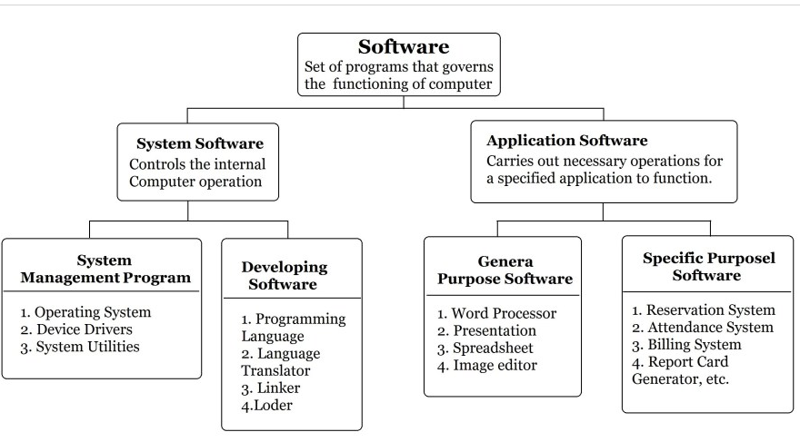
TYPE OF SOFTWARE

Slide 6
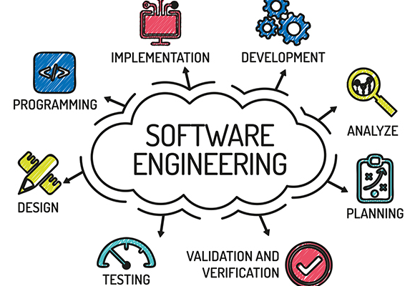
Software engineering
using appropriate theories and methods to solve problems bearing in mind organizational and financial constraints.
Software engineering is an engineering discipline that is concerned with all aspects of software production
technical process of development, project management , the development of tools, methods etc.
Notes:
Software engineering is an engineering discipline that is concerned with all aspects of software production from the early stages of system specification through to maintaining the system after it has gone into use.
Engineering discipline
Using appropriate theories and methods to solve problems bearing in mind organizational and financial constraints.
All aspects of software production
Not just technical process of development.
Also project management and the development of tools, methods etc. to support software production.

Slide 7
Who is in charge for the specification?
Product specification at initial stage and the changes later
Generic products
The software engineering team
Customized products
The customer
Agile value. Working software over Comprehensive document
Notes:
Generic product specification
The specification of what the software should do is owned by the software developer and decisions on software change are made by the developer.
Customized product specification
The specification of what the software should do is owned by the customer for the software and they make decisions on software changes that are required.
There are many other agents may involve in specification decision process but not mainly in charged.

Slide 8
Good software?
“Good” is a general attribute:
of a high quality or level
to be desired or approved of
Break-down “good” quality into required quality attributes:
performance
maintainable
dependable
usable
Notes:
Good software should deliver the required functionality and performance to the user and should be maintainable, dependable and usable.
Maintainability
Software should be written in such a way so that it can evolve to meet the changing needs of customers.
This is a critical attribute because software change is an inevitable requirement of a changing business environment.
Dependability (and security)
Software dependability includes a range of characteristics including reliability, security and safety.
Dependable software should not cause physical or economic damage in the event of system failure.
Malicious users should not be able to access or damage the system.
Efficiency (Performance)
Software should not make wasteful use of system resources such as memory and processor cycles.
Efficiency therefore includes responsiveness, processing time, memory utilisation, etc.
Acceptability (Usable)
Software must be acceptable to the type of users for which it is designed.
This means that it must be understandable, usable and compatible with other systems that they use.

Slide 9

Importance of software engineering
Quality can mean the difference between excellence and disaster
Airbus A400M Atlas crash in 2015, 4 killed
Notes:
Quality can mean the difference between excellence and disaster
This is one of the recent incidence that was account for software issues. The airplan crashed on duty, every people died. The pilots reported that the plane had a technical fault and asked permission to land, but hit an electricity pylon while attempting an emergency landing.
The consequence is more severe as the aircraft model is banned in many countries. At that time Airbus only delivered 12 out of 174 units ordered so far. So image how much does it cost
150+ under delivery
Suspended from German, Malaysian, and Turkish air forces

Slide 10
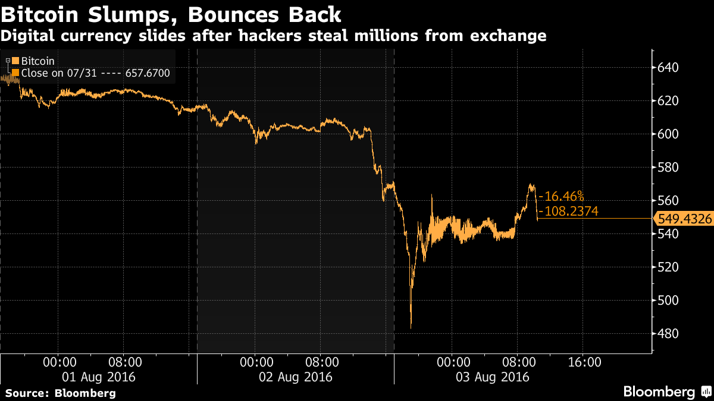
Importance of software engineering
8/2016: Security breach with Bitcoin cost 72 mil. Usd lost in market
Notes:
Global bitcoin community in the second-biggest security breach ever of such an exchange
Nearly 120,000 units of bitcoin worth about US$72 million was stolen from the exchange platform Bitfinex in Hong Kong. In a sunny day and you suddenly find out your bitcoin account is little bit less. The consequence is amplied in exchange market. As you can see from the chart.
The coming day bitcoin lost about 18% its value. the theft had done his job in spreading confusion and frustration among market traders
The source of the vulnerability appears to lie in how Bitfinex structured its accounts and its use of bitcoin wallet provider

Slide 11
Software costs
Software costs ~ computer system costs
Costs to maintain > to develop
Software engineering is concerned with cost-effective software development.
Notes:
Software costs often dominate computer system costs
The costs of software on a PC are often greater than the hardware cost.
Software costs more to maintain than it does to develop
For systems with a long life, maintenance costs may be several times development costs.
Software engineering is concerned with cost-effective software development.

Slide 12
Some FAQs about software engineering
Question | Answer
What is the difference between software engineering and computer science? | Computer science focuses on theory and fundamentals; software engineering is concerned with the practicalities of developing and delivering useful software.
What is the difference between software engineering and system engineering? | System engineering is concerned with all aspects of computer-based systems development including hardware, software and process engineering. Software engineering is part of this more general process.
Notes:
Some more FAQs
What are the key challenges facing software engineering?
Coping with increasing diversity, demands for reduced delivery times and developing trustworthy software.
What are the costs of software engineering?
Roughly 60% of software costs are development costs, 40% are testing costs. For custom software, evolution costs often exceed development costs.
What are the best software engineering techniques and methods?
While all software projects have to be professionally managed and developed, different techniques are appropriate for different types of system. For example, games should always be developed using a series of prototypes whereas safety critical control systems require a complete and analyzable specification to be developed. You can’t, therefore, say that one method is better than another.
What differences has the web made to software engineering?
The web has led to the availability of software services and the possibility of developing highly distributed service-based systems. Web-based systems development has led to important advances in programming languages and software reuse.

Slide 13
Importance of software engineering
We need:
Reliability & trustworthy products
Delivering on time
Reusable
Cost effective in changing/evolution
More?
Notes:
More and more, individuals and society rely on advanced software systems. We need to be able to produce reliable and trustworthy systems economically and quickly.
It is usually cheaper, in the long run, to use software engineering methods and techniques for software systems rather than just write the programs as if it was a personal programming project. For most types of system, the majority of costs are the costs of changing the software after it has gone into use.

Slide 14
Importance of software engineering
A bridge from customer needs to programming implementation
Customer
Software Engineering
Psofttware Engineer
First law of software engineering
Software engineer is willing to learn the problem domain
(problem cannot be solved without understanding it first)
Notes:
"You cannot solve it, unless you understand it."

Slide 15
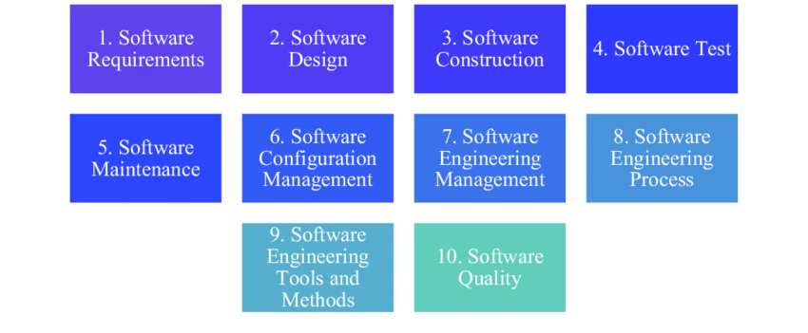

Fundamental Software engineering activities
Notes:
Software specification
customers and engineers define the software that is to be produced and the constraints on its operation.
Software development
the software is designed and programmed.
Software validation
the software is checked to ensure that it is what the customer requires.
Software evolution
the software is modified to reflect changing customer and market requirements.
Software process activities – An alternative
defining the software development process to be used
managing the development project
describing the intended software product
designing the product
implementing the product
testing the parts of the product
integrating the parts and testing them as a whole
maintaining the product

Slide 16
General issues that affect most software
Heterogeneity
Increasingly, systems are required to operate as distributed systems across networks that include different types of computer and mobile devices.
Business and social change
Business and society are changing incredibly quickly as emerging economies develop and new technologies become available. They need to be able to change their existing software and to rapidly develop new software.
Security and trust
As software is intertwined with all aspects of our lives, it is essential that we can trust that software.

Slide 17
Software diversity
Many different types of software system
Stand-alone
Transaction-based
Embedded system
Batch processing
Entertainment
Modeling and simulation
System of systems
Software development is context-specific
Large companies
SME
Startups
In-house
Outsourcing
➔ no universal set of software techniques applicable to all!
Notes:
There are many different types of software system and there is no universal set of software techniques that is applicable to all of these.
The software engineering methods and tools used depend on the type of application being developed, the requirements of the customer and the background of the development team.
Application types
Stand-alone applications
These are application systems that run on a local computer, such as a PC. They include all necessary functionality and do not need to be connected to a network.
Interactive transaction-based applications
Applications that execute on a remote computer and are accessed by users from their own PCs or terminals. These include web applications such as e-commerce applications.
Embedded control systems
These are software control systems that control and manage hardware devices. Numerically, there are probably more embedded systems than any other type of system.
Batch processing systems
These are business systems that are designed to process data in large batches. They process large numbers of individual inputs to create corresponding outputs.
Ex: Virus scanning
Entertainment systems
These are systems that are primarily for personal use and which are intended to entertain the user.
Systems for modeling and simulation
These are systems that are developed by scientists and engineers to model physical processes or situations, which include many, separate, interacting objects.
Data collection systems
These are systems that collect data from their environment using a set of sensors and send that data to other systems for processing.
Systems of systems
These are systems that are composed of a number of other software systems.

Slide 18
Software engineering fundamentals
Some fundamental principles apply to all types of software system:
Use a managed and understood development process
Consider dependability and performance
Understand and manage the software specification and requirements
Try reuse software
Notes:
Some fundamental principles apply to all types of software system, irrespective of the development techniques used:
Systems should be developed using a managed and understood development process.
Of course, different processes are used for different types of software.
Dependability and performance are important for all types of system.
Understanding and managing the software specification and requirements (what the software should do) are important.
Where appropriate, you should reuse software that has already been developed rather than write new software.

Slide 19

Software engineering ethics
Ethics?
(Oxford dictionary) Moral principles that govern a person’s behaviour or the conducting of an activity.
Fundamental Software engineering ethics
Software engineering involves wider responsibilities than simply the application of technical skills.
Software engineers must behave in an honest and ethically responsible way if they are to be respected as professionals.
Ethical behaviour is more than simply upholding the law but involves following a set of principles that are morally correct.
Notes:
Vietnames?
…

Slide 20
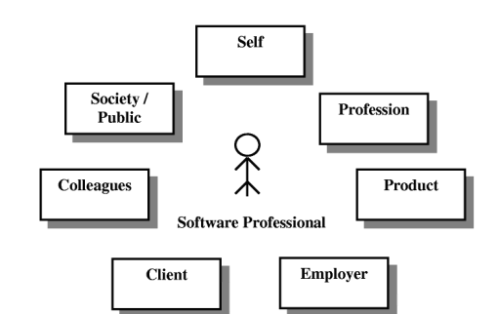
Software engineering ethics
Notes:
PUBLIC - Software engineers shall act consistently with the public interest.
CLIENT AND EMPLOYER - Software engineers shall act in a manner that is in the best interests of their client and employer consistent with the public interest.
PRODUCT - Software engineers shall ensure that their products and related modifications meet the highest professional standards possible.
JUDGMENT - Software engineers shall maintain integrity and independence in their professional judgment.
MANAGEMENT - Software engineering managers and leaders shall subscribe to and promote an ethical approach to the management of software development and maintenance.
PROFESSION - Software engineers shall advance the integrity and reputation of the profession consistent with the public interest.
COLLEAGUES - Software engineers shall be fair to and supportive of their colleagues.
SELF - Software engineers shall participate in lifelong learning regarding the practice of their profession and shall promote an ethical approach to the practice of the profession.

Slide 21
ACM Code of Ethics and Professional Conduct
1.1 Contribute to society and human well-being.
1.2 Avoid harm to others.
1.3 Be honest and trustworthy.
1.4 Be fair and take action not to discriminate.
1.5 Honor property rights including copyrights and patent.
1.6 Give proper credit for intellectual property.
1.7 Respect the privacy of others.
1.8 Honor confidentiality.

Slide 22

Software engineering and sustainability
Notes:
The Sustainable Development Goals or Global Goals are a collection of 17 interlinked global goals designed to be a "blueprint to achieve a better and more sustainable future for all". The SDGs were set in 2015 by the United Nations General Assembly and are intended to be achieved by the year 2030.

Slide 23

Software engineering and sustainability - Example
Green Software Engineering is an emerging discipline at the intersection of climate science, software practices and architecture, electricity markets, hardware and data centre design.
Green Software Engineering concerns the design, development and operation of software-intensive products in a way that reduces pollution, promotes sustainability, and minimizes risk to human health and the environment without sacrificing economic viability and efficiency
https://principles.green/
Notes:
The Sustainable Development Goals or Global Goals are a collection of 17 interlinked global goals designed to be a "blueprint to achieve a better and more sustainable future for all". The SDGs were set in 2015 by the United Nations General Assembly and are intended to be achieved by the year 2030.

Slide 24
Software engineering and sustainability - Example
Carbon: Build applications that are carbon efficient.
Electricity: Build applications that are energy efficient.
Carbon Intensity: Consume electricity with the lowest carbon intensity.
Embodied Carbon: Build applications that are hardware efficient.
Energy Proportionality: Maximize the energy efficiency of hardware.
Networking: Reduce the amount of data and distance it must travel across the network.
Demand Shaping: Build carbon-aware applications.
Measurement & Optimization: Focus on step-by-step optimizations that increase the overall carbon efficiency.
https://principles.green/
Notes:
The Sustainable Development Goals or Global Goals are a collection of 17 interlinked global goals designed to be a "blueprint to achieve a better and more sustainable future for all". The SDGs were set in 2015 by the United Nations General Assembly and are intended to be achieved by the year 2030.

Slide 25
Summary
Software engineering is an engineering discipline that is concerned with all aspects of software production.
Essential software product attributes are maintainability, dependability and security, efficiency and acceptability.
The high-level activities of specification, development, validation and evolution are part of all software processes.
The fundamental notions of software engineering are universally applicable to all types of system development.

Slide 26
Summary (cont.)
There are many different types of system and each requires appropriate software engineering tools and techniques for their development.
The fundamental ideas of software engineering are applicable to all types of software system.
Software engineers have responsibilities to the engineering profession and society. They should not simply be concerned with technical issues.
Sustainability is an emerging concern in all engineering discipline, including software development and operation.

